Slide 1


Thanh Long Company Business Management System
Supervisor: Mr Phan Trường Lâm
Students:
Nguyễn Minh Đức
Nguyễn Tiến Khiêm
Nguyễn Minh Sơn
Nguyễn Mạnh Linh
Ngô Văn Thắng

Slide 2
Contents
1. Introduction
2. Project Management Plan
3. Requirement Specifications
4. Design Description
5. Test Documentation
6. Demo, Q&A

Slide 3
Part 1: Introduction
The People
Background
Literature Review
Our Proposal
Products

Slide 4
The people
Mr. Phan Trường Lâm
- Instructor
Nguyễn Minh Đức
Nguyễn Minh Sơn
- Project Manager
- Developer
- Tester
- Developer
- Designer
Nguyễn Tiến Khiêm
Nguyễn Mạnh Linh
- Developer
- Designer
- Developer
- Technical
- Configuration Manager
Ngô Văn Thắng
Test Lead -Tester

Slide 5
Background
1
Using traditional methods to manage projects
Difficulty to manage projects
3
Inconvenient and inefficient
4
2
Behind schedule and expensive

Slide 6


Literature review
1
Expensive cost
2
Inconvenient
3
Unwieldy

Slide 7
Our proposals
Thanh Long construction company
Small construction companies
Reduce management cost
Increase economic efficiency
Company
Economic
Network
User Friendly
Make the system user-friendly, Vietnamese and convenient.
Have best performance
Using cloud computing
More faster and safe

Slide 8
Part 2: Software Project Management Plan
The proposed system and scope
Development Environment
Process
Project organization
Project Planning

Slide 9
Proposed system & scope
Propose
Providing tool to manage projects in individual construction company
Scope
Manage project staffs
Manage project tasks
Manage reports
Manage message system

Slide 10

Dev Environment Hardware
CPU: Intel(R) Pentium3 2.0 GHz or better supported
RAM: 512MB RAM for Windows XP/Win7
Hard Drive: 2Gb of free space
Connect internet or USB 3G
Server Hardware

Slide 11




Dev Environment Software

Slide 12
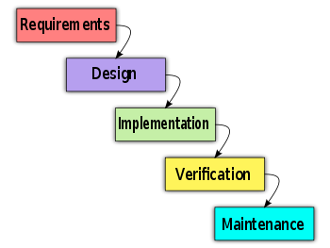
Process
Follow Waterfall model

Slide 13
Project Organization
Project Manager
DucNM
Analysis and design team
Developer
QA & Tester
DucNM
KhiemNT
SonNM
KhiemNT
DucNM
ThangNV
SonNM
LinhNM

Slide 14

Project Planning
Follow Capstone Project requirements
Buffer: 20% (about 3 weeks)
“Consumed” buffer: 1.5 weeks
Submit all reports on time

Slide 15
Part 3: System Requirement Specifications
User Requirements
System Requirements
Non-functional requirements*

Slide 16
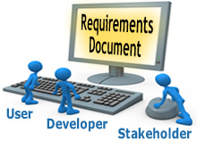
User requirements
Administration
Director
Human Resource Manager
Operator
Project Manager

Slide 17
User Requirements Admin
Log in – log out, View General Information
View list, add, update and search account
View list, create, update, delete and search project space
View list, view detail, add and search message

Slide 18
User Requirements Director
Log in – log out, View General Information
View project list, search project, view task project detail
View project report list, search project report, view project report detail
View Human Resource Information, Decide Require Human Resource
View list, view detail, add and search message

Slide 19
User Requirements Human Resource Manager
Log in – log out, View General Information
can view list, delete, add, update, search staff
view list, delete, add, update, specialty
view list of project, search project, view project detail
search staff and add resource to project
View Human Resource Information, Decide Require Human Resource
view list, view detail, add and search message

Slide 20
User Requirements Operator
Log in – log out, View General Information
View task list & project information, view task detail
View list, view detail, create and search daily report
View list, view detail, add and search message

Slide 21
User Requirements Project Manager
Log in – log out, View General Information
view list, add, update, delete, require staff and search task
view list, search, assign task, confirm human resource, remove human resource
view list, add, update, delete operator
view require human resource information
view task information, change task status, manage task constraint, Create line chart, manage document task

Slide 22
User Requirements Project Manager
View project information & task list, change project status, view projects’ documentations, Gantt-chart, update project's information
View project list, search project
View list, view detail, update and search daily report
View list, search, create, view detail
View list, view detail, add and search message

Slide 23
System requirements
Document requirements for each use case
Each includes:
Use case diagram
Actor
Summary
Triggers
Preconditions
Post conditions
Success scenarios
Alternative scenarios
Exceptions
Relationship
Business rules

Slide 24
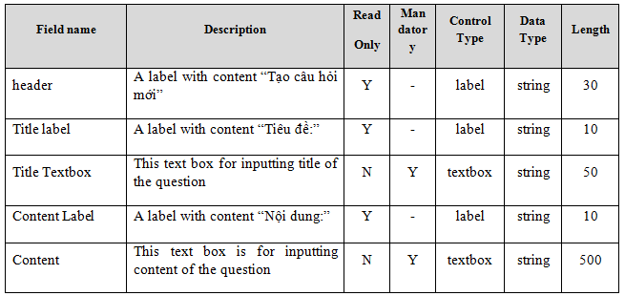
System requirements
Data Fields Definition:
Field name
Description
Read-only
Mandatory
Control type
Data type
Length

Slide 25
Non-functional requirements
Usability
Availability
Reliability
Security
Security
Performance
Maintainability

Slide 26
Usability
Front-end language: Vietnamese
Easy to use.
Clear and convenient user interface

Slide 27

Reliability
Database and files: backed up regularly
Easily upgrade to expanded

Slide 28

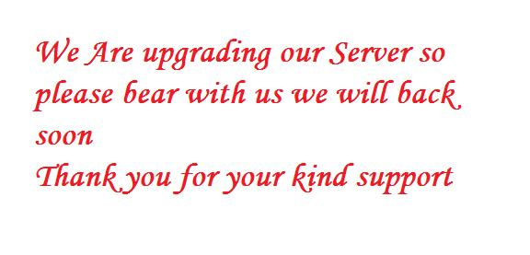
Availability
Run 24/7

Slide 29

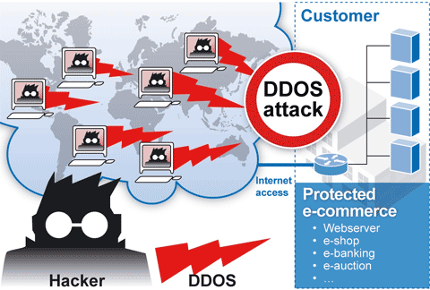
Security
Privacy: protect user information
User password must be invisible even to admin
These pages are secured by SSL.
All sensitive information is encrypted using DES

Slide 30

Maintainability
Follow coding standard and naming conventions
Loosely coupled design
Logging functionality

Slide 31
Performance
Load time: average 1.5 second
Caching
Frequently accessed data
Reference data

Slide 32
Part 4: Software Design Description
Architectural design
Detailed design
Database design

Slide 33
Architectural design
Overall design
Components
Patterns

Slide 34
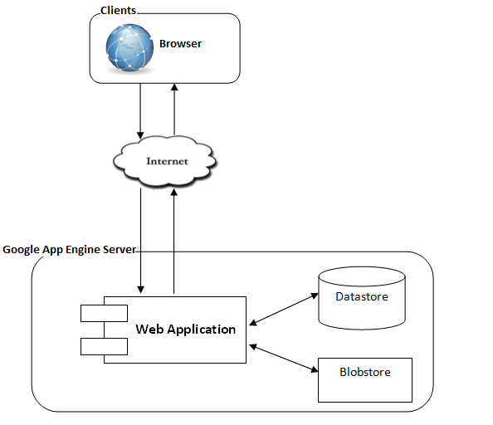
Overall Design

Slide 35
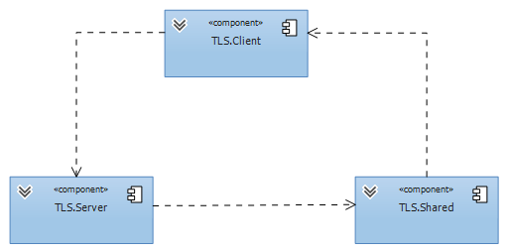
Components

Slide 36
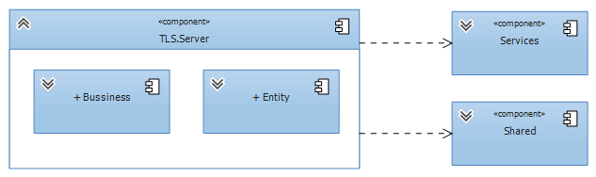
Server component
Server Component

Slide 37
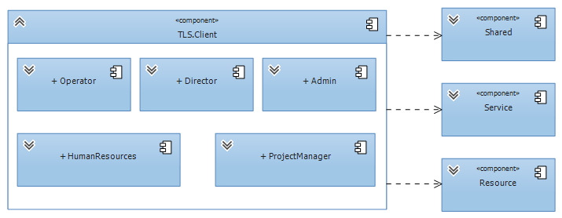
Client component
Client Component

Slide 38
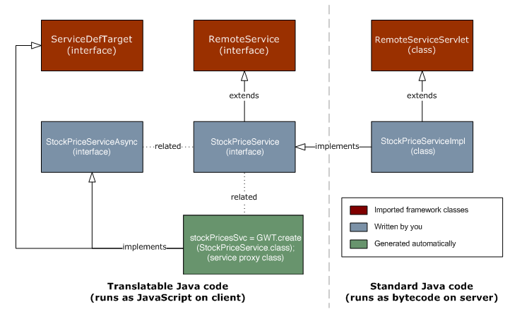
Architectural Design patterns
Client – server

Slide 39
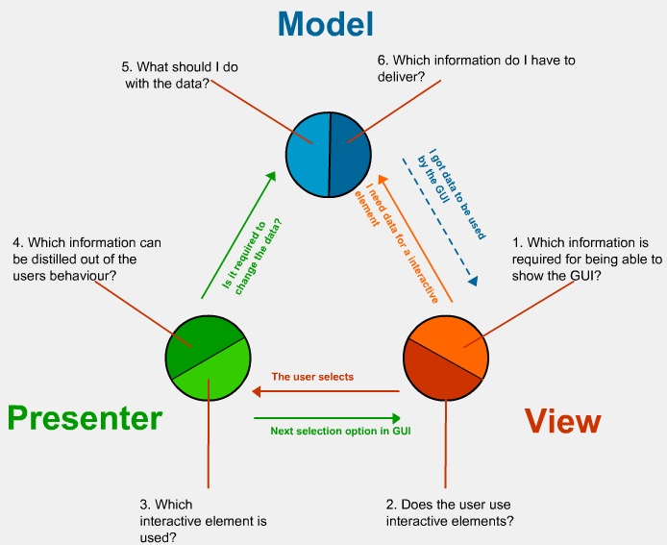
Architectural Design patterns
MVP

Slide 40
Detailed design
Design for each use case
Class diagram
Class explanation
Sequence diagram

Slide 41
Class Diagram
Class diagram example
Class diagram example

Slide 42
Class Diagram
Sequence diagram example
Sequence diagram example

Slide 43
Database design
Business tables.
Every table has a primary key named Id.
Max length and null ability strictly follow field definitions.

Slide 44
ER Diagram
Notes:
Crow foot notation

Slide 45
Part 5: Software Test Documentation
Include:
Features to be tested
Features not to be tested
Test case
Check list

Slide 46
Test result
Number of test cases:
Number of passed cases:
Number of failed cases:
Number of not tested cases:

Slide 47


Tested & not tested
Unit test
Integration test
System test
Performance test

Slide 48
Demo

Slide 49
Q&A

Slide 50
Thank You !

